Slide 1
IT Infrastructure Architecture
Infrastructure Building Blocks
and Concepts
Performance Concepts
(chapter 5)

Slide 2
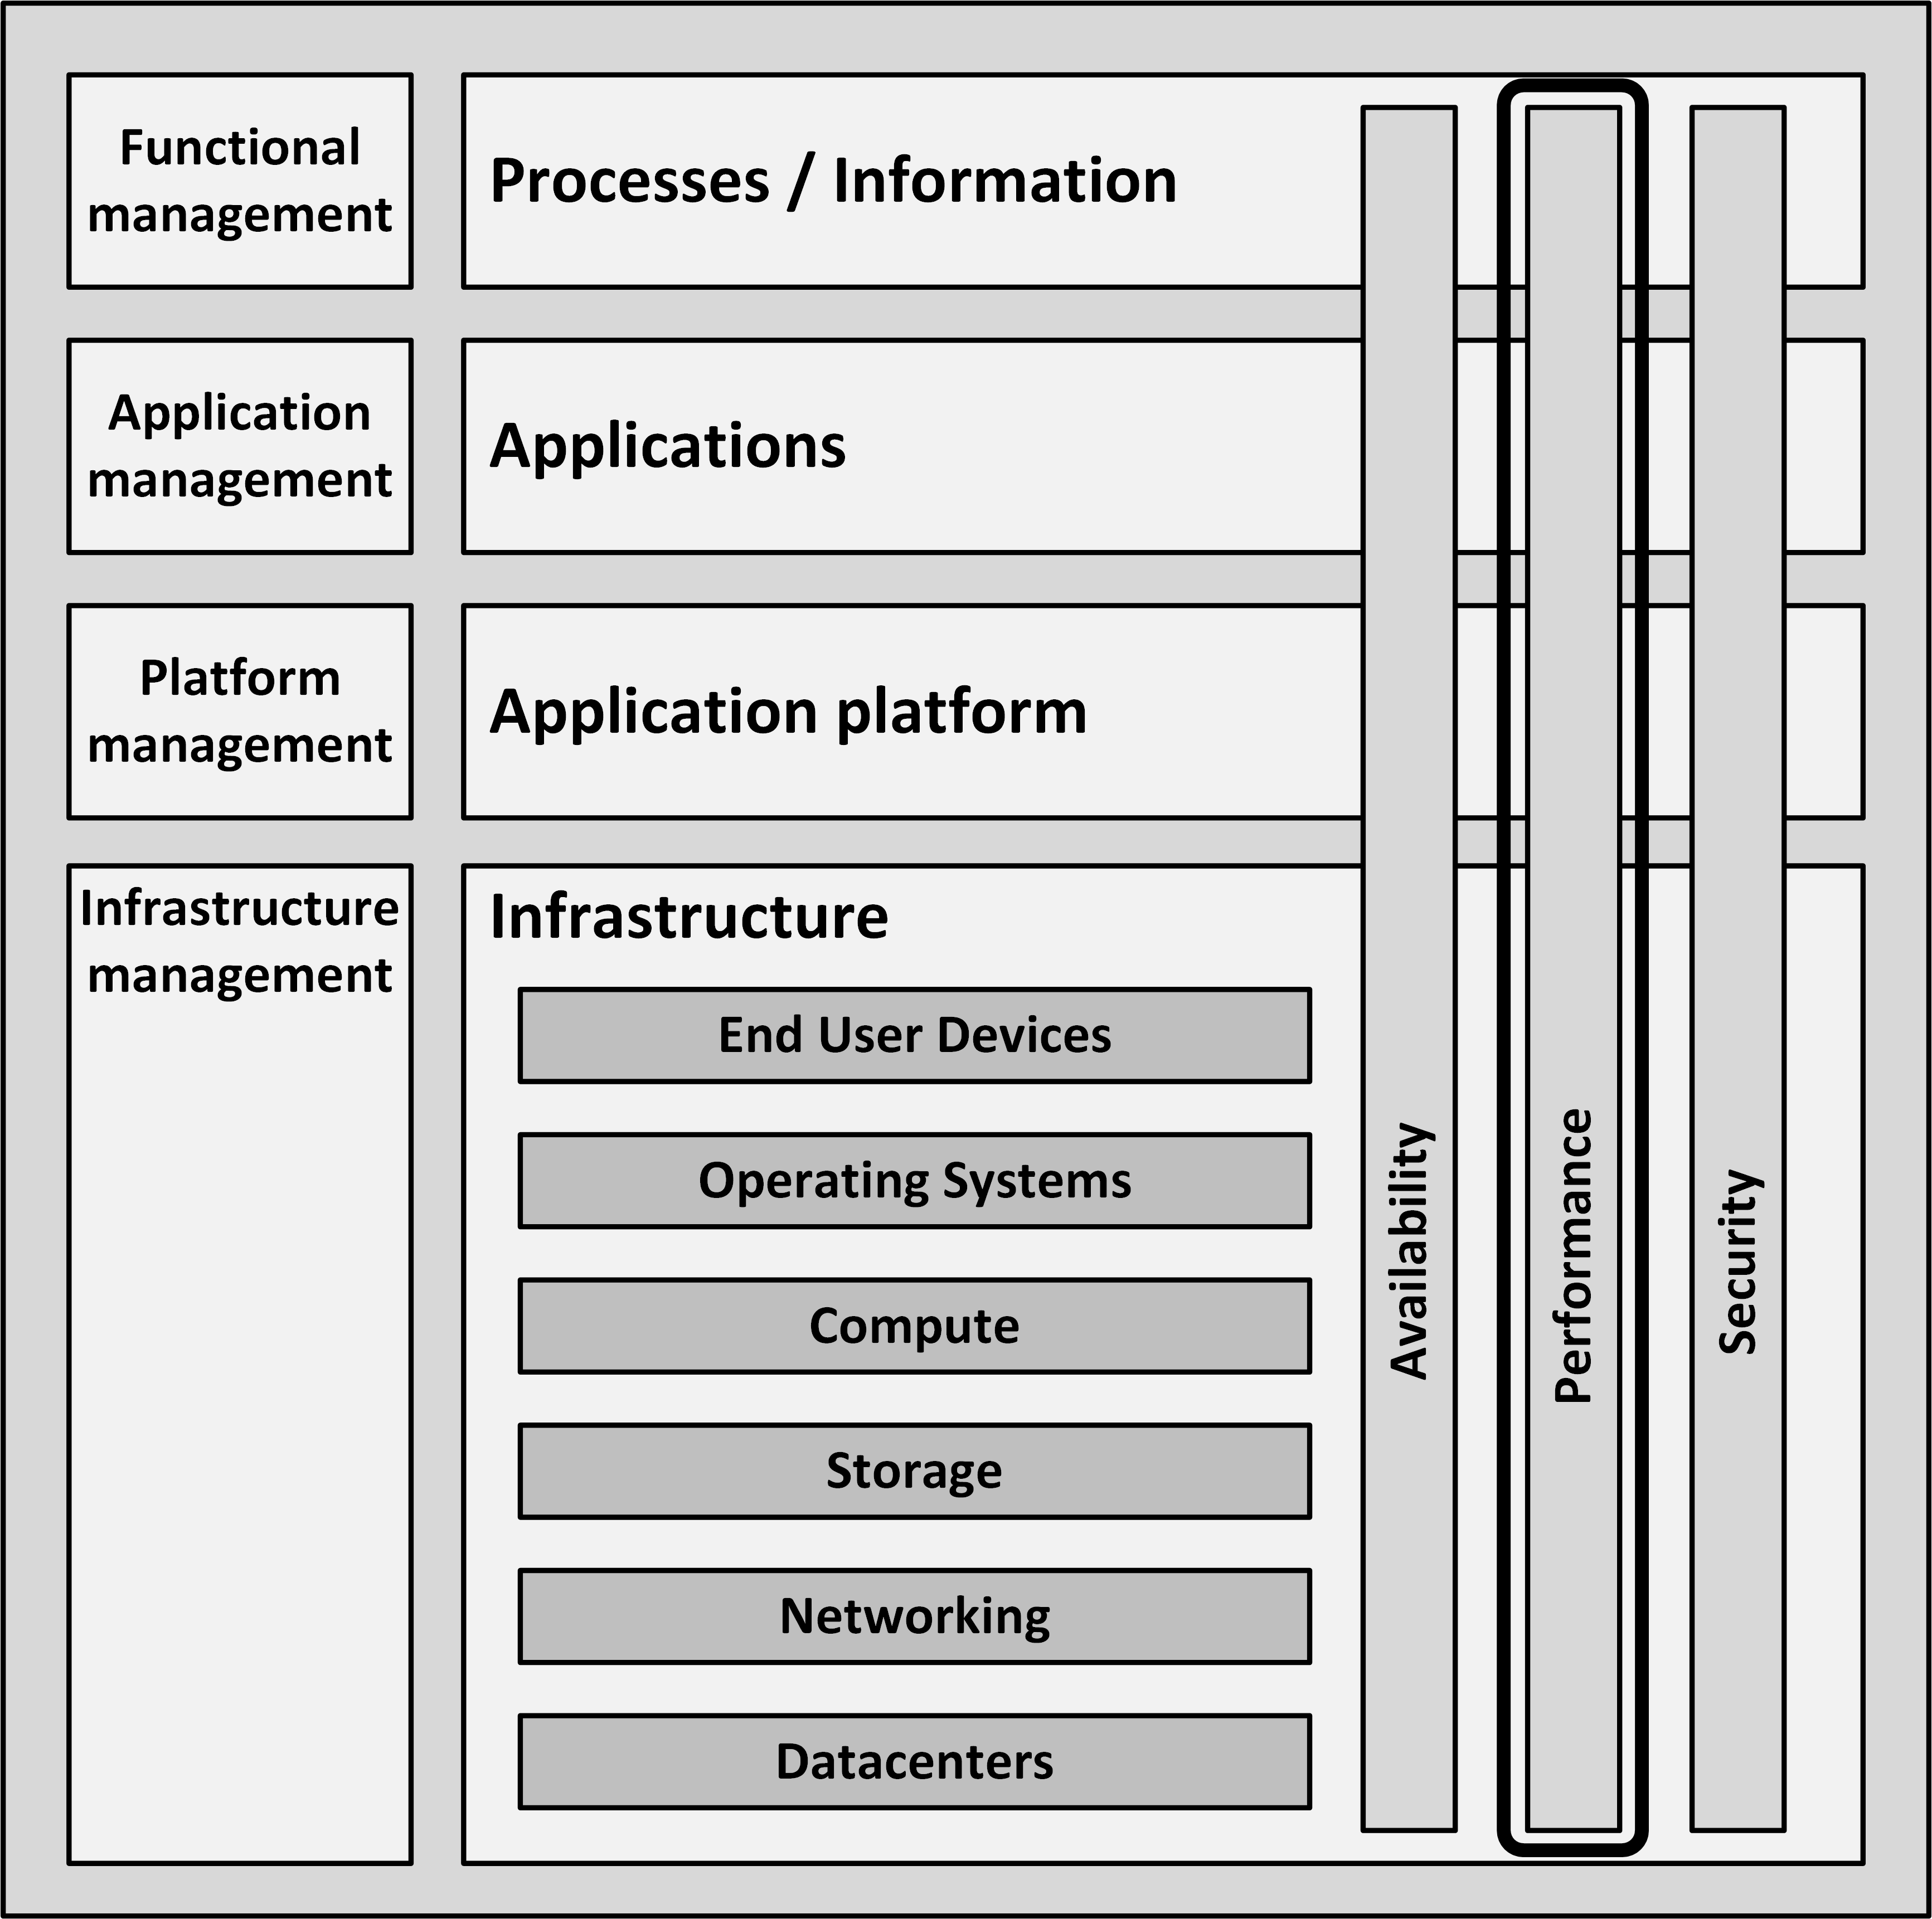
Introduction
Performance is a typical hygiene factor
Nobody notices a highly performing system
But when a system is not performing well enough, users quickly start complaining

Slide 3
Perceived performance
Perceived performance refers to how quickly a system appears to perform its task
In general, people tend to overestimate their own patience
People tend to value predictability in performance
When the performance of a system is fluctuating, users remember a bad experience
Even if the fluctuation is relatively rare

Slide 4
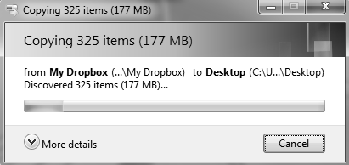

Perceived performance
Inform the user about how long a task will take
Progress bars
Splash screens

Slide 5
Performance during infrastructure design

Slide 6
Performance during infrastructure design
A solution must be designed, implemented, and supported to meet the performance requirements
Even under increasing load
Calculating performance of a system in the design phase is:
Extremely difficult
Very unreliable

Slide 7
Performance during infrastructure design
Performance must be considered:
When the system works as expected
When the system is in a special state, like:
Failing parts
Maintenance state
Performing backup
Running batch jobs
Some ways to do this are:
Benchmarking
Using vendor experience
Prototyping
User Profiling

Slide 8
Benchmarking
A benchmark uses a specific test program to assess the relative performance of an infrastructure component
Benchmarks compare:
Performance of various subsystems
Across different system architectures

Slide 9
Benchmarking
Benchmarks comparing the raw speed of parts of an infrastructure
Like the speed difference between processors or between disk drives
Not taking into account the typical usage of such components
Examples:
Floating Point Operations Per Second – FLOPS
Million Instructions Per Second – MIPS

Slide 10
Vendor experience
The best way to determine the performance of a system in the design phase: use the experience of vendors
They have a lot of experience running their products in various infrastructure configurations
Vendors can provide:
Tools
Figures
Best practices

Slide 11
Prototyping
Also known as proof of concept (PoC)
Prototypes measure the performance of a system at an early stage
Building prototypes:
Hiring equipment from suppliers
Using datacenter capacity at a vendor’s premise
Using cloud computing resources
Focus on those parts of the system that pose the highest risk, as early as possible in the design process

Slide 12
User profiling
Predict the load a new software system will pose on the infrastructure before the software is actually built
Get a good indication of the expected usage of the system
Steps:
Define a number of typical user groups (personas)
Create a list of tasks personas will perform on the new system
Decompose tasks to infrastructure actions
Estimate the load per infrastructure action
Calculate the total load

Slide 13
User profiling personas/tasks

Slide 14
User profiling Infrastructure load

Slide 15
Performance of a running system

Slide 16
Managing bottlenecks
The performance of a system is based on:
The performance of all its components
The interoperability of various components
A component causing the system to reach some limit is referred to as the bottleneck of the system
Every system has at least one bottleneck that limits its performance
If the bottleneck does not negatively influence performance of the complete system under the highest expected load, it is OK

Slide 17
Performance testing
Load testing - shows how a system performs under the expected load
Stress testing - shows how a system reacts when it is under extreme load
Endurance testing - shows how a system behaves when it is used at the expected load for a long period of time

Slide 18
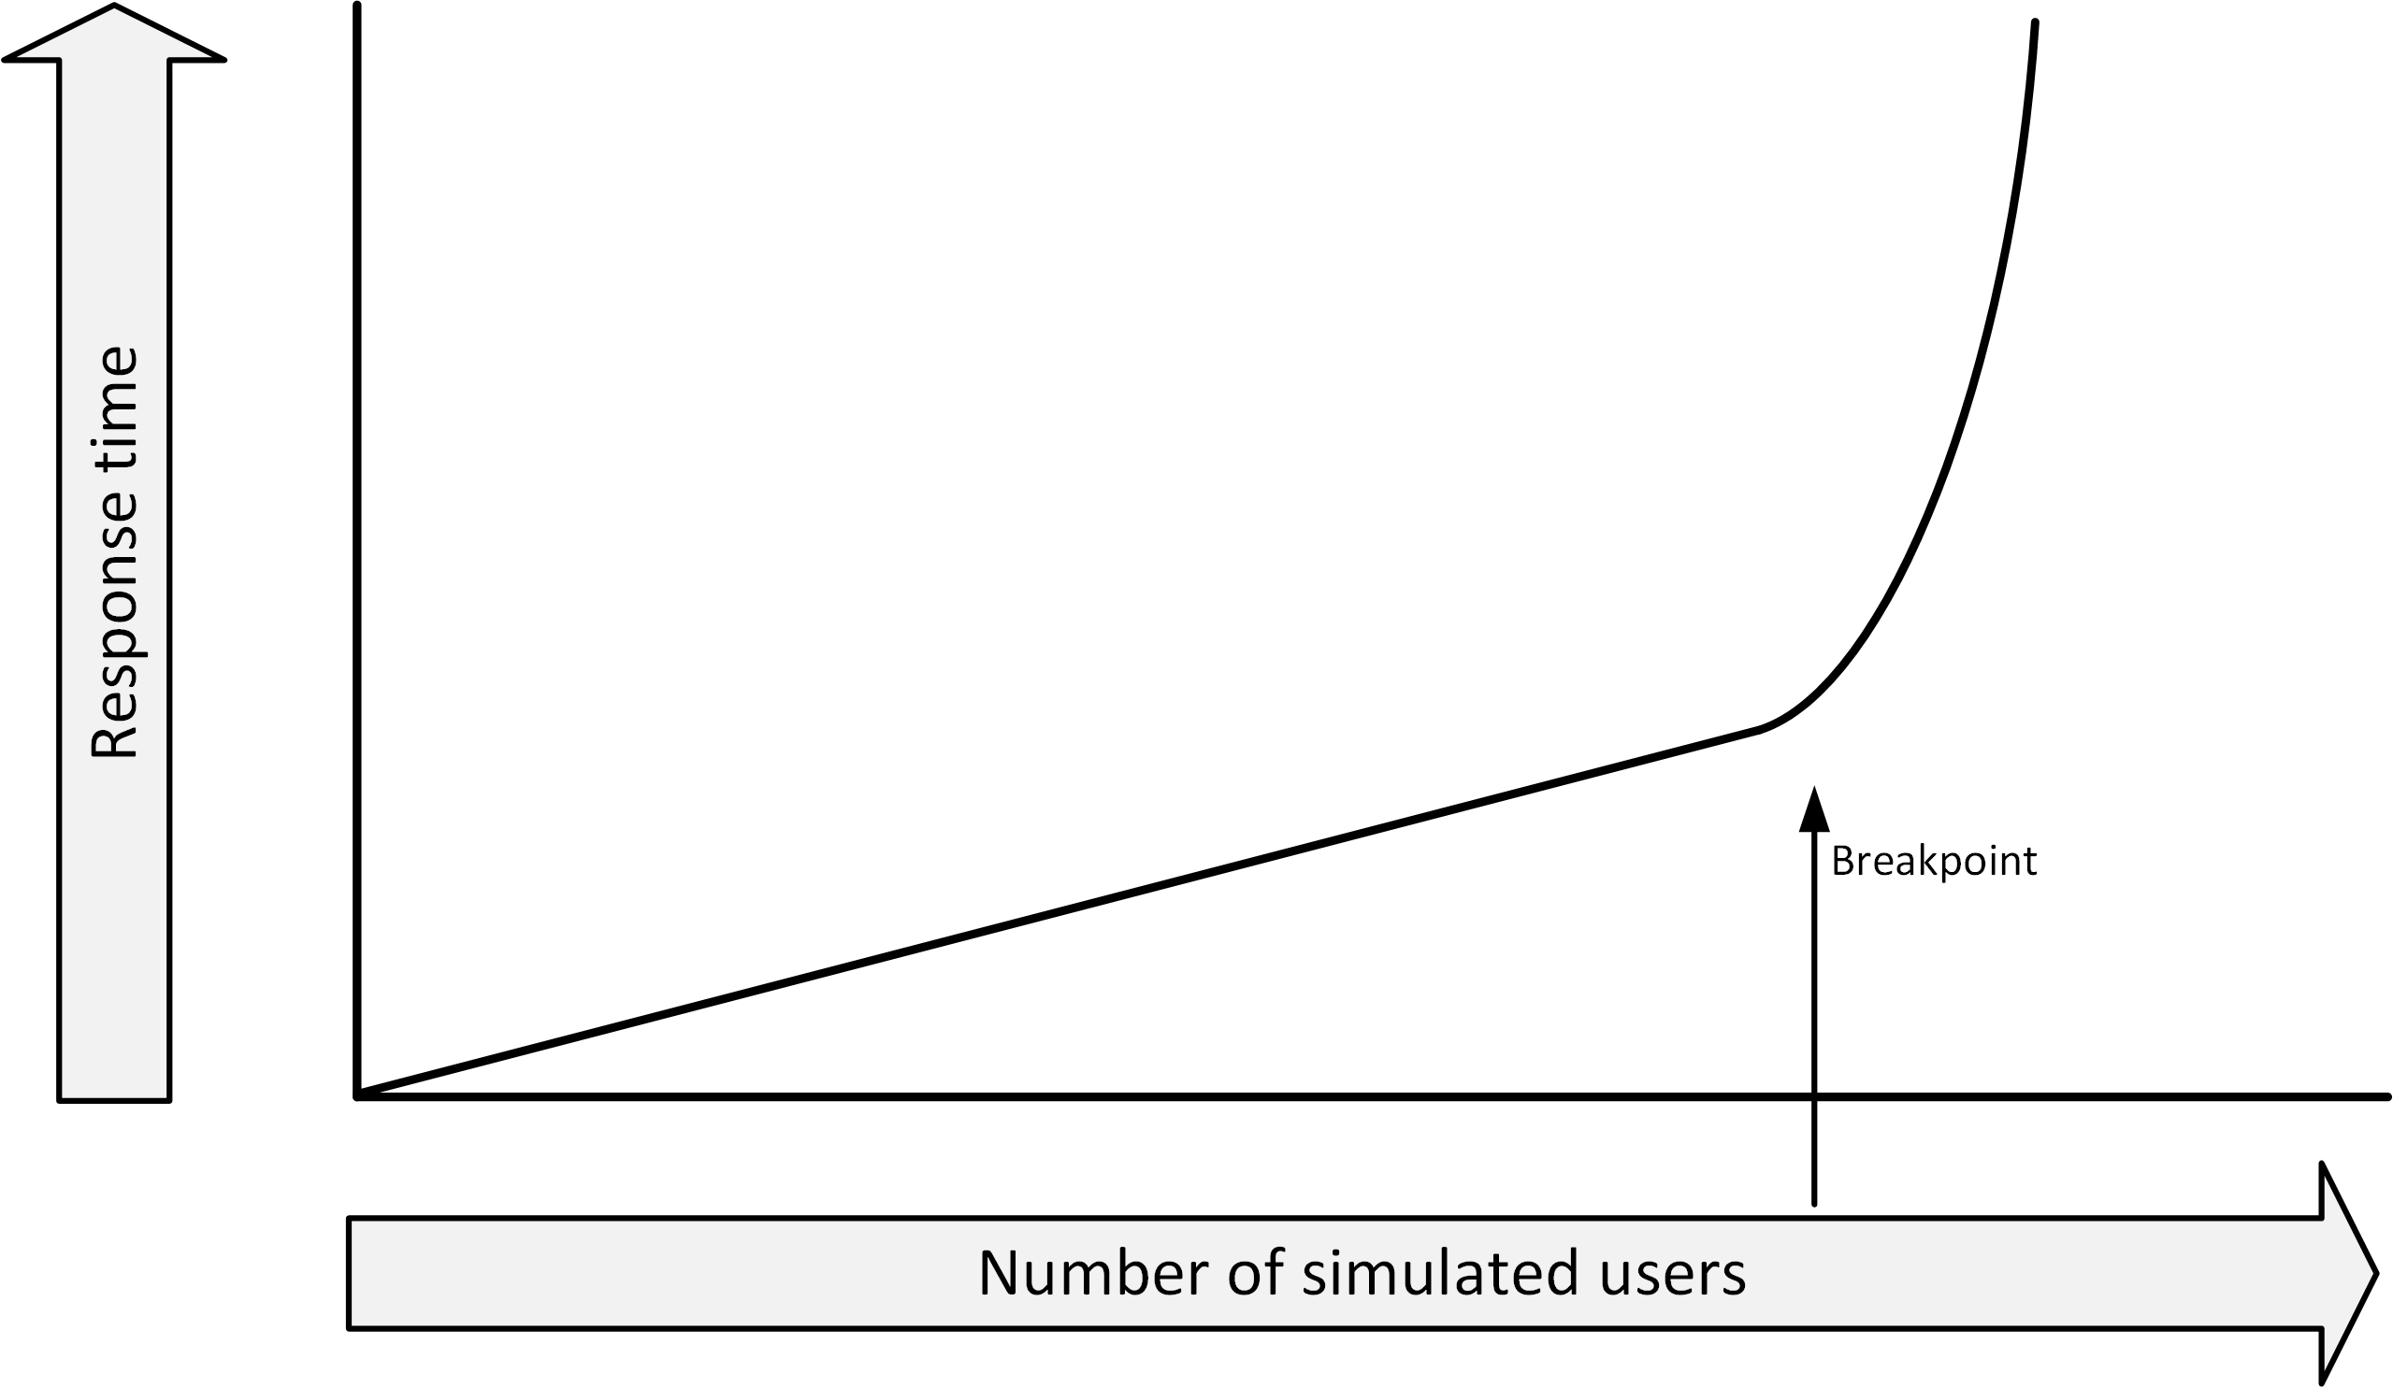
Performance testing - Breakpoint
Ramp up the load
Start with a small number of virtual users
Increase the number over a period of time
The test result shows how the performance varies with the load, given as number of users versus response time.

Slide 19
Performance testing
Performance testing software typically uses:
One or more servers to act as injectors
Each emulating a number of users
Each running a sequence of interactions
A test conductor
Coordinating tasks
Gathering metrics from each of the injectors
Collecting performance data for reporting purposes

Slide 20
Performance testing
Performance testing should be done in a production-like environment
Performance tests in a development environment usually lead to results that are highly unreliable
Even when underpowered test systems perform well enough to get good test results, the faster production system could show performance issues that did not occur in the tests
To reduce cost:
Use a temporary (hired) test environment

Slide 21
Performance patterns

Slide 22
Increasing performance on upper layers
80% of the performance issues are due to badly behaving applications
Application performance can benefit from:
Database and application tuning
Prioritizing tasks
Working from memory as much as possible (as opposed to working with data on disk)
Making good use of queues and schedulers
Typically more effective than adding compute power

Slide 23
Disk caching
Disks are mechanical devices that are slow by nature
Caching can be implemented i:
Disks
Disk controllers
Operating system
All non-used memory in operating systems is used for disk cache
Over time, all memory gets filled with previously stored disk requests and prefetched disk blocks, speeding up applications.
Cache memory:
Stores all data recently read from disk
Stores some of the disk blocks following the recently read disk blocks

Slide 24
Caching

Slide 25
Web proxies
When users browse the internet, data can be cached in a web proxy server
A web proxy server is a type of cache
Earlier accessed data can be fetched from cache, instead of from the internet
Benefits:
Users get their data faster
All other users are provided more bandwidth to the internet, as the data does not have to be downloaded again

Slide 26
Operational data store
An Operational Data Store (ODS) is a read-only replica of a part of a database, for a specific use
Frequently used information is retrieved from a small ODS database
The main database is used less for retrieving information
The performance of the main database is not degraded

Slide 27
Front-end servers
Front-end servers serve data to end users
Typically web servers
To increase performance, store static data on the front-end servers
Pictures are a good candidate
Significantly lowers the amount of traffic to back-end systems
In addition, a reverse proxy can be used
Automatically cache most requested data

Slide 28
In-memory databases
In special circumstances, entire databases can be run from memory instead of from disk
In-memory databases are used in situations where performance is crucial
Real-time SCADA systems
High performance online transaction processing (OLTP) systems
As an example, in 2011 SAP AG introduced HANA, an in-memory database for SAP systems
Special arrangements must be made to ensure data is not lost when a power failure occurs

Slide 29
Scalability
Scalability indicates the ease in with which a system can be modified, or components can be added, to handle increasing load
Two ways to scale a system:
Vertical scaling (scale up) - adding resources to a single component
Horizontal scaling (scale out) - adding more components to the infrastructure

Slide 30
Scalability – Vertical scaling
Adding more resources, for example:
Server: more memory, CPU’s
Network switch: adding more ports
Storage: Replace small disks by larger disks
Vertical scaling is easy to do
It quickly reaches a limit
The infrastructure component is “full”

Slide 31
Scalability – Horizontal scaling
Adding more components to the infrastructure, for example:
Adding servers to a web server farm
Adding disk cabinets to a storage system
In theory, horizontal scaling scales much better
Be aware of bottlenecks
Doubling the number of components does not necessarily double the performance
Horizontal scaling is the basis for cloud computing
Applications must be aware of scaling infrastructure components

Slide 32
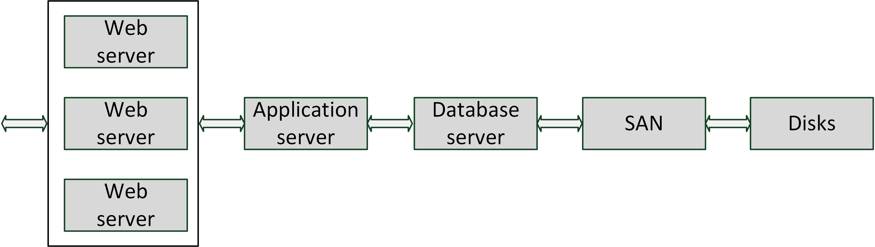
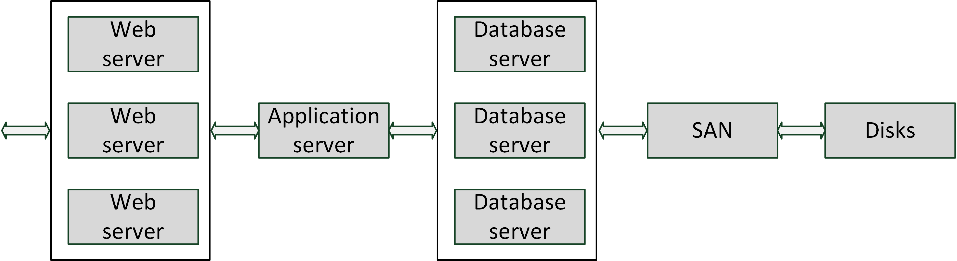
Scalability – Horizontal scaling

Slide 33
Load balancing
Load balancing uses multiple servers that perform identical tasks
Examples:
Web server farm
Mail server farm
FTP (File Transfer Protocol) server farm
A load balancer spreads the load over the available machines
Checks the current load on each server in the farm
Sends incoming requests to the least busy server

Slide 34
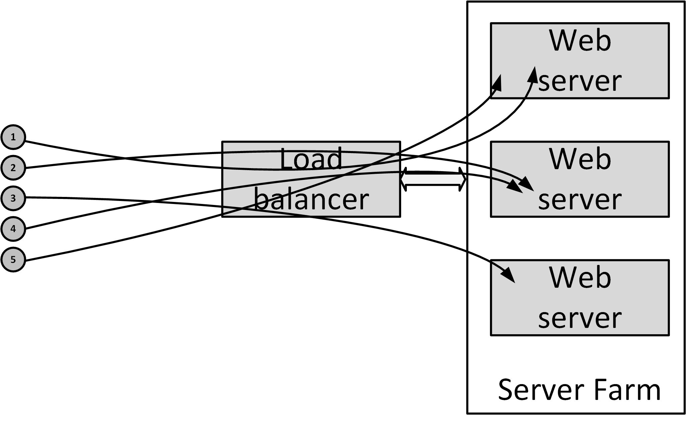
Load balancing

Slide 35
Load balancing
Advanced load balancers can spread the load based on:
The number of connections a server has
The measured response time of a server
The application running on a load balanced system must be able to cope with the fact that each request can be handled by a different server
The load balancer should contain the states of the application
The load balancing mechanism can arrange that a user’s session is always connected to the same server
If a server in the server farm goes down, its session information becomes inaccessible and sessions are lost

Slide 36
Load balancing
A load balancer increases availability
When a server in the server farm is unavailable, the load balancer notices this and ensures no requests are sent to the unavailable server until it is back online again
The availability of the load balancer itself is very important
Load balancers are typically setup in a failover configuration

Slide 37
Load balancing
Network load balancing:
Spread network load over multiple network connections
Most network switches support port trunking
Multiple Ethernet connections are combined to get a virtual Ethernet connection providing higher throughput
The load is balanced over the connections by the network switch
Storage load balancing:
Using multiple disks to spread the load of reads and writes
Use multiple connections between servers and storage systems

Slide 38
High performance clusters
High performance clusters provide a vast amount of computing power by combining many computer systems
A large number of cheap off the-shelf servers can create one large supercomputer
Used for calculation-intensive systems
Weather forecasts
Geological research
Nuclear research
Pharmaceutical research
TOP500.org

Slide 39
Grid Computing
A computer grid is a high performance cluster that consists of systems that are spread geographically
The limited bandwidth is the bottleneck
Examples:
SETI@HOME
CERN LHC Computing Grid (140 computing centers in 35 countries)
Broker firms exist for commercial exploitation of grids
Security is a concern when computers in the grid are not under control

Slide 40
Design for use
Performance critical applications should be designed as such
Tips:
Know what the system will be used for
A large data warehouse needs a different infrastructure design than an online transaction processing system or a web application
Interactive systems are different than batch oriented systems
When possible, try to spread the load of the system over the available time

Slide 41
Design for use
In some cases, special products must be used for certain systems
Real-time operating systems
In-memory databases
Specially designed file systems
Use standard implementation plans that are proven in practice
Follow the vendor's recommended implementation
Have the vendors check the design you created
Move rarely used data from the main systems to other systems
Moving old data to a large historical database can speed up a smaller sized database

Slide 42
Capacity management
Capacity management guarantees high performance of a system in the long term
To ensure performance stays within acceptable limits, performance must be monitored
Trend analyses can be used to predict performance degradation
Anticipate on business changes (like forthcoming marketing campaigns)

